Slide 1
openSUSE.Asia Summit
Logo Competition
Kukuh Syafaat
openSUSE-ID
cho2@opensuse.{org, id}

Slide 2


About Logo Competition
Started on the first openSUSE.Asia Summit.

Slide 3
About Logo Competition (2)
2014
  https://news.opensuse.org/2014/07/21/opensuse-asia-summit-announces-its-logo-contest/
2015
  https://news.opensuse.org/2015/08/24/opensuse-asia-summit-2015-logo-design-contest-is-back/
2016
  https://news.opensuse.org/2016/06/30/opensuse-asia-summit-2016-logo-competition-announced/
2017
  https://news.opensuse.org/2017/07/14/opensuse-asia-summit-2017-logo-competition/
2018
  https://news.opensuse.org/2018/05/29/opensuse-asia-summit-2018-logo-competition/
2019
  https://news.opensuse.org/2019/05/15/opensuse-asia-summit-2019-logo-competition/

Slide 4
Rules
License: CC-BY-SA 4.0
Format: SVG
Original and not include any third party materials
Reflect the openSUSE community in Asia
Follow openSUSE Project Trademark Guidelines and Branding Guidelines
Avoid brand name/trademark; inappropriate, offensive, hateful, tortuous, defamatory, slanderous or libelous illustration, etc.

Slide 5
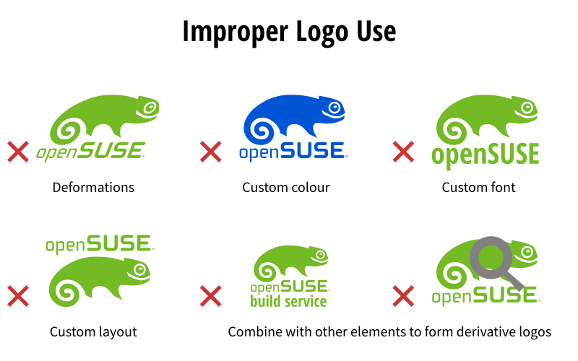
Common Mistake
OpenSUSE
OpenSuse
OpenSuSe
...

Slide 6

Prize
“Geeko Mystery Box”

Slide 7

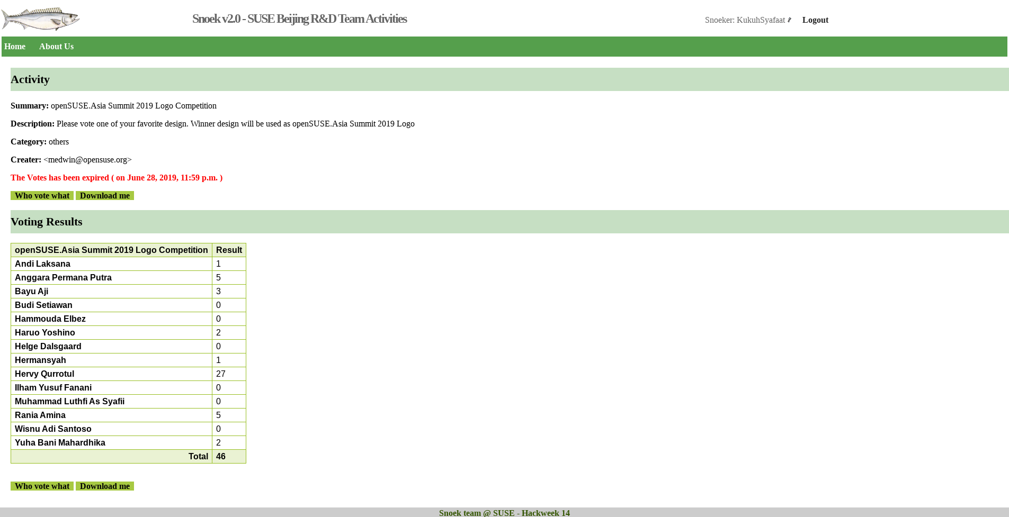
Vote
Using Snoek
  https://vote.opensuse-asia.org
Voted by public/openSUSE Community or by Committee

Slide 8
The Winner

Slide 9

2014 (*W.H*!)
https://news.opensuse.org/2014/09/12/opensuse-asia-summit-2014-we-have-a-logo-now/

Slide 10

2015 (Kukuh Syafaat - ID)
https://news.opensuse.org/2015/10/02/we-have-a-logo-for-opensuse-asia-summit-2015/

Slide 11

2016 (Ramadoni Ashudi - ID)
https://news.opensuse.org/2016/08/12/20067/

Slide 12

2017 (Ramadoni Ashudi - ID)
https://news.opensuse.org/2017/09/13/design-selected-for-opensuse-asia-summit/

Slide 13

2018 (Herbanu Tri Sasongko - ID)
news.o.o N/A

Slide 14
2019 (Hervy Qurrotul - ID)
https://news.opensuse.org/2019/07/09/opensuse-asia-summit-2019-logo-competition-winner/

Slide 15
Preparing yourself for
openSUSE.Asia Summit 2020 Logo Competition...

Slide 16
… and Co-Conference Logo Competition 2020.
openSUSE Conference X LibreOffice Conference
https://news.opensuse.org/2019/09/27/co-conference-logo-competition-for-2020/

Slide 17
Thank You

